Slide 1
1
Telco-Customer-Churn Prediction Analysis
Presentedby : -
Manish Rajak

Slide 2
1. Introduction 2
This project explores customer churn in the telecom industry using interactive visual analytics. The dataset contains detailed records of customer demographics, services, and billing behavior. Using Plotly Express, we perform rich, interactive exploratory data analysis (EDA). Key churn patterns are visualized across features like tenure, contract type, and charges. Special attention is given to identifying blank or inconsistent entries (e.g., TotalCharges). Dynamic visualizations like heatmaps, bar charts, and customer funnels uncover deep insights. We highlight high-risk customer segments based on usage and payment behavior. All graphs are designed to be clear, insightful, and business-friendly. This analysis helps stakeholders understand churn factors without complex modeling. The project reflects strong data interpretation and visualization skills using modern Python tools.

Slide 3
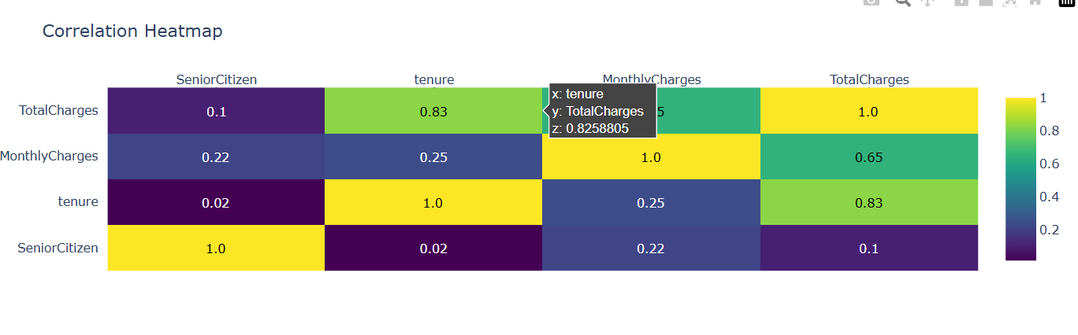
KEY INSIGHTS:
1. TotalCharges & Tenure (Strong +0.83):-The longer customers stay (tenure), the more they spend (TotalCharges). Loyal customers = More revenue.
2. MonthlyCharges & TotalCharges (+0.65):- Higher monthly bills lead to higher total spending over time.
3. Tenure & MonthlyCharges (Weak -0.02):- Monthly bills don’t really change how long customers stay. Price hikes may not push them away.
4. SeniorCitizen (No Strong Links):-Being a senior doesn’t strongly affect spending or loyalty.¶

Slide 4
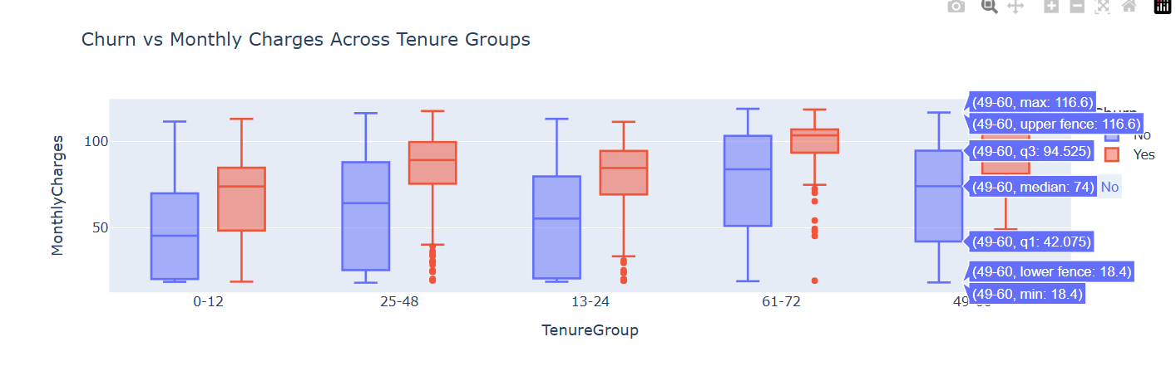
Key Insights from Monthly Charges vs Tenure Group (Churn Analysis
1. High churn is observed among new customers (0–12 months) who are paying higher monthly charges. These users are likely leaving due to early dissatisfaction or pricing concerns.
2. Mid-tenure customers (13–48 months) show a moderate churn rate, especially when their charges are above average. They may be reconsidering the value for cost over time.
3. Long-term customers (49–72 months) have the lowest churn rate and usually pay lower, stable charges, indicating strong loyalty and satisfaction.¶

Slide 5
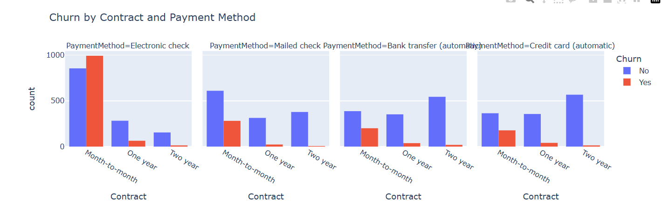
KEY INSIGHTS:
Month-to-month contracts have the highest churn, especially among customers using Electronic checks. This shows that flexible contracts + high-risk payment methods = high churn.
2. One-year and Two-year contracts show much lower churn, regardless of payment method. These longer-term contracts encourage customer retention.
3. Customers using Credit cards or Bank transfers tend to churn less, suggesting these methods may be preferred by more stable, long-term users.¶

Slide 6
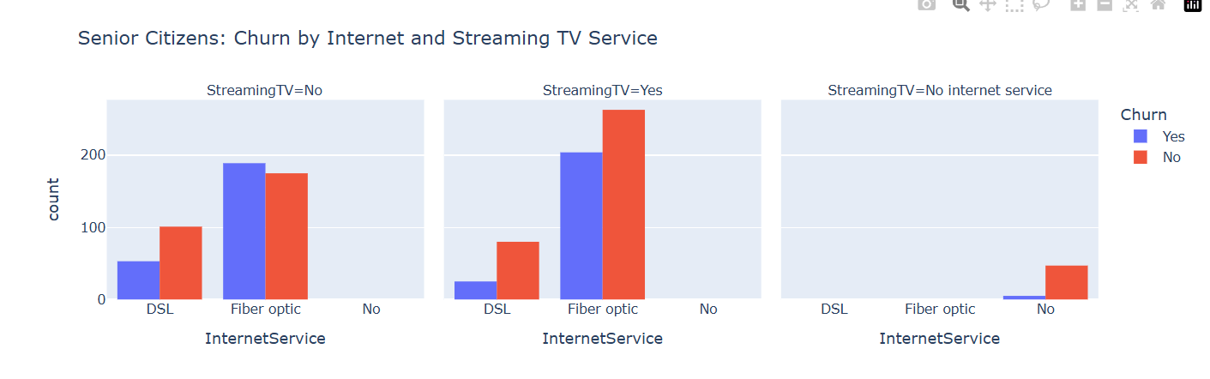
KEY INSIGHTS:
1. Senior citizens using Fiber optic internet are most likely to leave, especially if they also have Streaming TV. This may be due to higher costs or too many technical services.
2. Those with DSL internet show moderate churn, but still more than those with no internet service.
3. Senior citizens without internet and without Streaming TV rarely leave, indicating they prefer simple, low-cost plans.

Slide 7
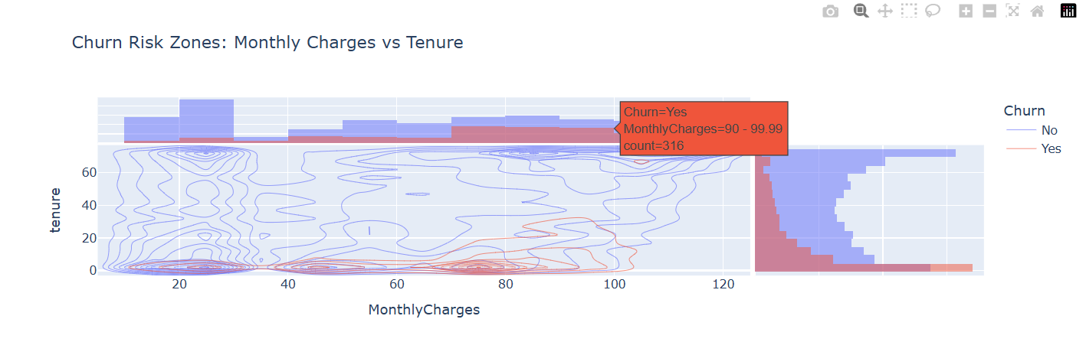
KEY INSIGHTS:
Customers with high monthly charges and low tenure churn the most.New customers who pay a lot are most likely to leave early.
2. Customers with low tenure but lower charges have mixed churn behavior.Some stay, some leave — possibly based on service experience.
3. Long-term customers (those who have been with us for a long time) rarely leave, even if prices go up. They are loyal and comfortable with our service and pricing.

Slide 8
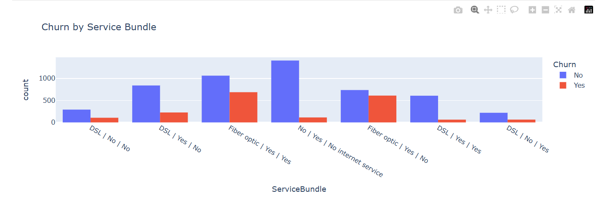
8
KEY INSIGHTS:
1. Internet-only users leave more often – People who only have internet (without phone or TV) are more likely to cancel.
2. Bundles keep customers longer – Those who have internet, phone, and TV together stay with the company more.
3. Phone + TV without internet is unusual – Very few customers have just phone and TV service (might be a data error).

Slide 9
Conclusion
Through insightful exploratory data analysis and interactive visualizations using Plotly Express, this project successfully uncovers the hidden patterns behind customer churn. By analyzing service usage, contract types, and payment behaviors, we’ve highlighted the most influential factors driving customer exit. These visual insights enable business teams to quickly understand churn dynamics and take targeted actions to improve retention. The project not only demonstrates strong data storytelling but also bridges the gap between raw data and strategic business decisions.

Slide 10
Thank You!!!!

